Slide 1
HUMAN GEOGRAPHY : DEFINITION, NATURE, SCOPE & MAJOR SUBFIELDS
Dr. Tanmoy Dhibor
Assistant Professor
Department of Geography
Hooghly Women’s College
Dr. Tanmoy Dhibor

Slide 2
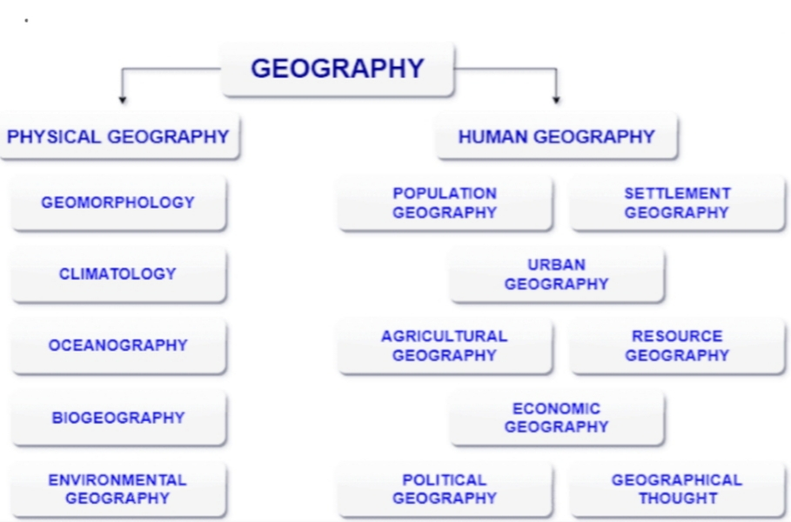
INTRODUCTION
GEOGRAPHY: From the Greek language ‘to write about the earth’. As a modern academic discipline, geography is concerned with the analysis of the physical and human characteristics of the earth’s surface from a spatial perspective.
There are two main branches in geography :
PHYSICAL GEOGRAPHY
HUMAN GEOGRAPHY

Slide 3
A. PHYSICAL GEOGRAPHY: Physical geography is the study of natural world. For e.g. mountains, weather /climate , volcanoes, natural disasters, animal, seas and ocean etc. Basically anything that is about nature and how the world works.
B. HUMAN GEOGRAPHY: Human geography is the study of how the humans have affected by the environment and why civilizations are where they are

Slide 4
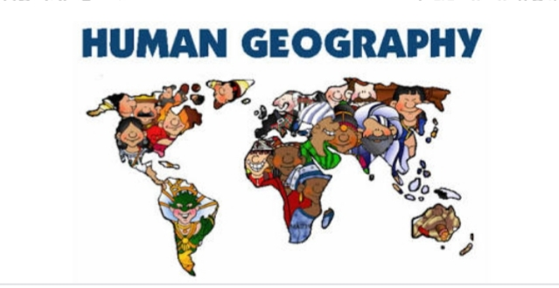
HUMAN GEOGRAPHY: One of the two major divisions of geography; the spatial analysis of human population, its cultures, activities, and landscapes.

Slide 5
DEFINITION OF HUMAN GEOGRAPHY: “Human geography is the synthetic study of relationship between human societies and earth’s surface.” - RATZEL “Human geography is the study of the changing relationship between the unresting man and the unstable earth.” - ELLEN C. SEMPLE “Conception resulting from a more synthetic knowledge of the physical laws governing our earth and of the relations between the living beings which inhabit it.” - PAUL VIDAL DE LA BLACHE

Slide 6
Human geography studies the inter-relationship between the physical environment and socio cultural environment created by human beings through mutual interaction with each other. Geography is ‘the study if the earth as home of humans’. Its nature is interdisciplinary and integrative. Geography looks at the earth’s surface from two different but interrelated perspectives, known as systematic & regional.
NATURE OF HUMAN GEOGRAPHY:

Slide 7
SCOPE OF HUMAN GEOGRAPHY: In human geography, the major thrust is on the study of human societies in their relation to the habitat or environment. Human geography covers a very wide field or its scope is enormous. It embraces the study of human races; the growth, fertility, distribution, mortality, and density of population of the various parts of the world, their demographic attributes and migration patterns; and physical and cultural difference between human groups and economic activities. It deals with the world as it is and with the world as it might be made to be. The impact of man on environment is also a topic of growing importance in human geography.

Slide 8
MAJOR SUBFIELDS OF HUMAN GEOGRAPHY

Slide 9
HUMAN GEOGRAPHY HAS A NUMBER OF SUB-BRANCHES- 1.ANTHROPOGEOGRAPHY: It largely deals with racial phenomena in their spatial context. 2.CULTURAL GEOGRAPHY: It focusses on the origin, components and impact of human cultures, both material and non-material. 3.ECONOMIC GEOGRAPHY: Study of the earth in relation to the productive activities of man. The earth is the main source of wealth, such as forests, mines, waters, and fisheries. This overlaps with economics. 4.SOCIAL GEOGRAPHY: Study of the earth in relation to the social activities of man. the various human communities and settlement patterns are affected by the nature of the landscape. 5.POLITICAL GEOGRAPHY: Study of the earth in relation to the political activities of man. Main focus remains for creation and transformation of political and administrative region.

Slide 10
6.HISTORICAL GEOGRAPHY: Spatial and temporal trends of geographical phenomena are studied in historical geography. 7. POPULATION GEOGRAPHY: It is the study of various dimensions of population like its population distribution, density, composition, fertility, mortality, migration etc. 8. SETTLEMENT GEOGRAPHY: It is the study of rural/ urban settlements, their size, distribution, functions, hierarch, and off various other parameters of settlement system. 9. BEHAVIORAL GEOGRAPHY: It is an approach to human geography that attempts to understand human activities in space, place, and environment by studying it at the level of the individual person.

Slide 11
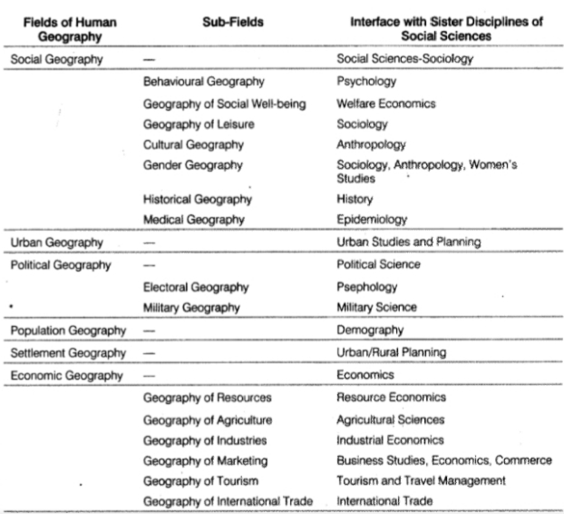
SUB-FIELDS OF HUMAN GEOGRAPHY

